Slide 1

Group–D: Java installation and compilation in ubuntu
Presented By
Prajwal S M
Sachin K S
Hanumantha Reddy
Srinivas M

Slide 2
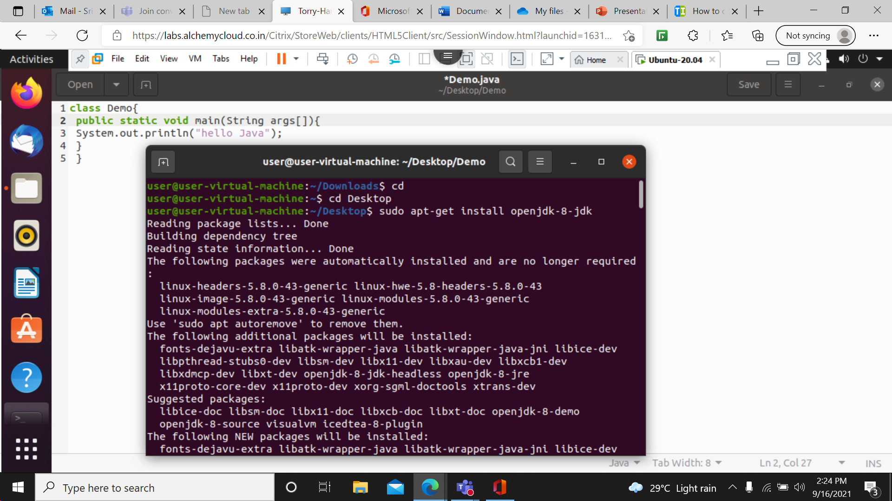
Java Installation

Slide 3
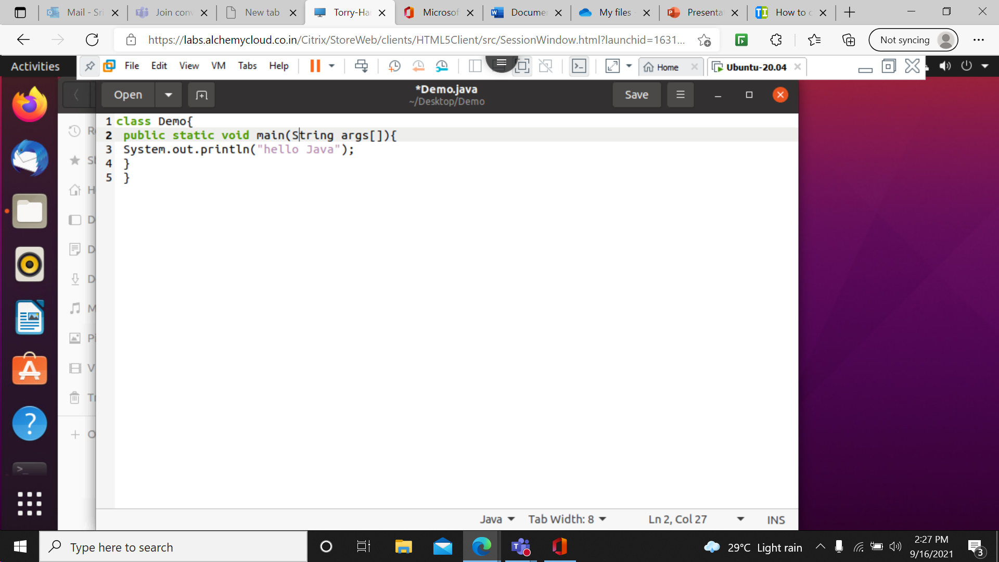
Write the Program
We can write the program in text file and save as filename.java or you can write your program using any text editor. in the terminal you can use VIM or nano editor. Example vim filename.java

Slide 4
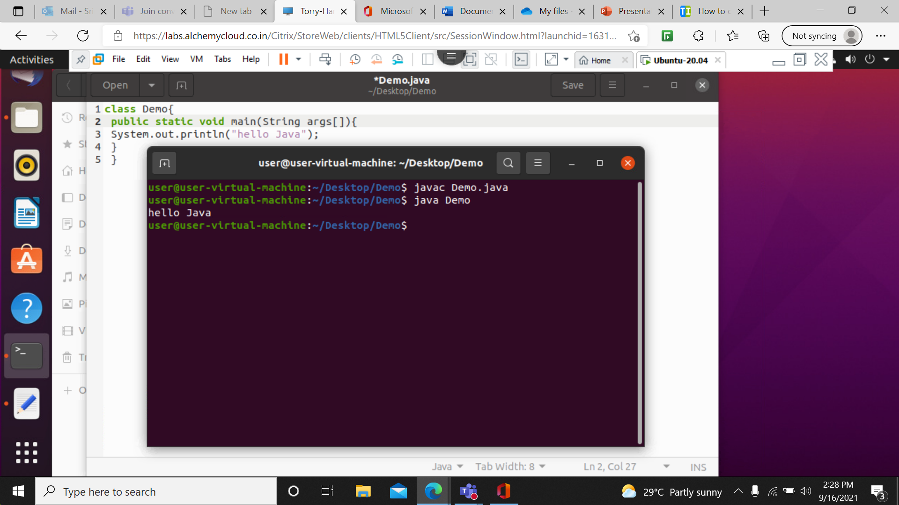
Complication

Slide 5
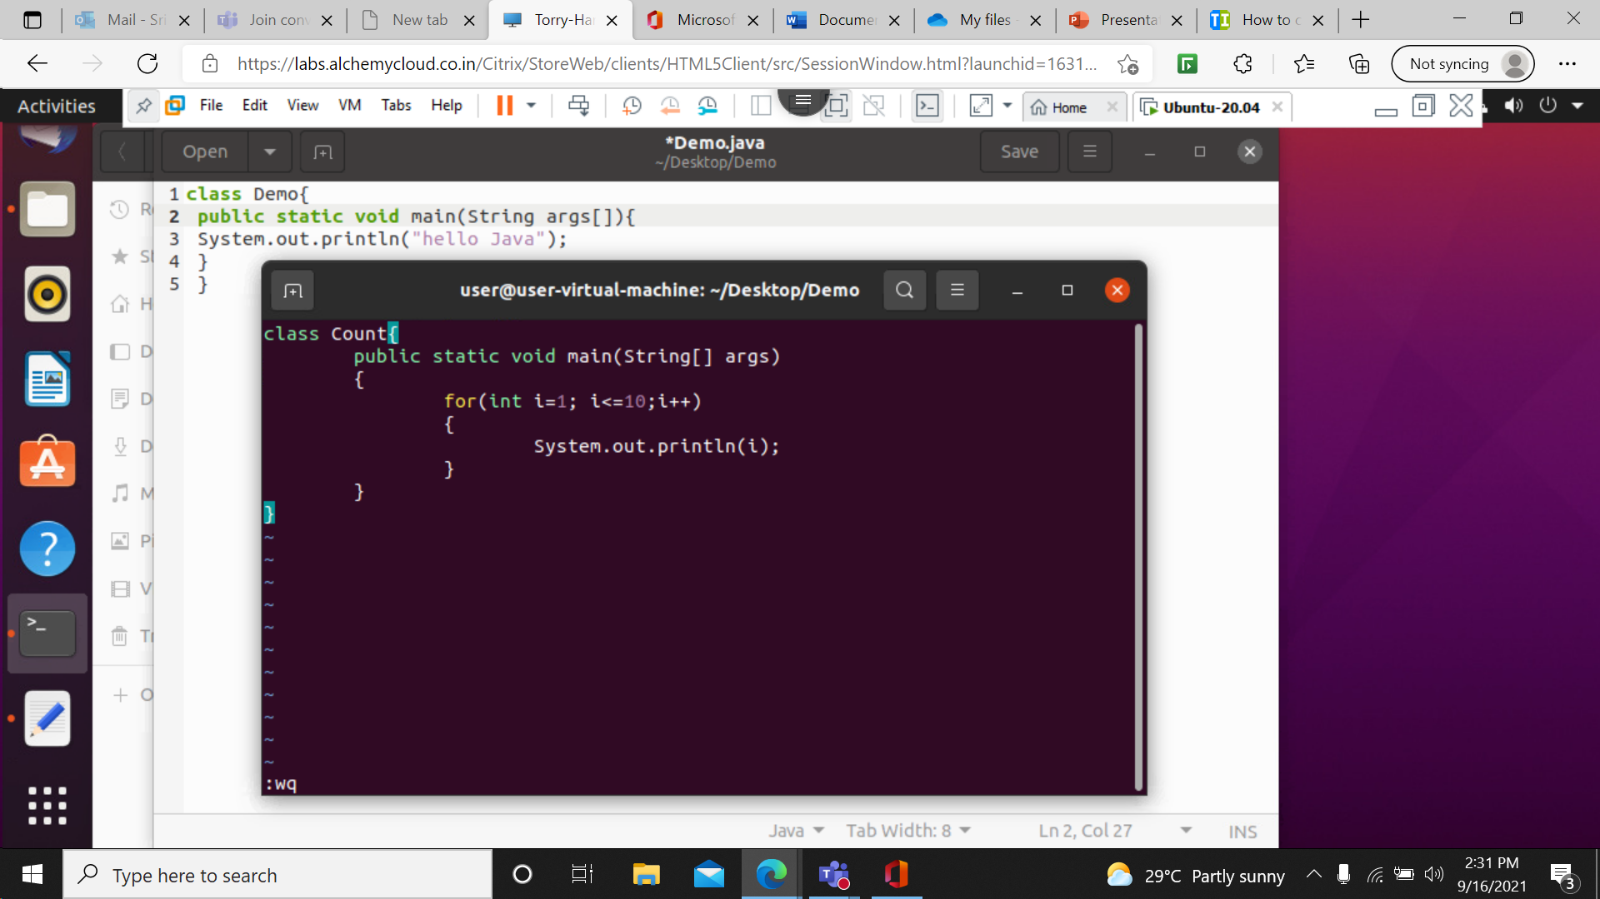
Example : Program to Display 1 to 10

Slide 6
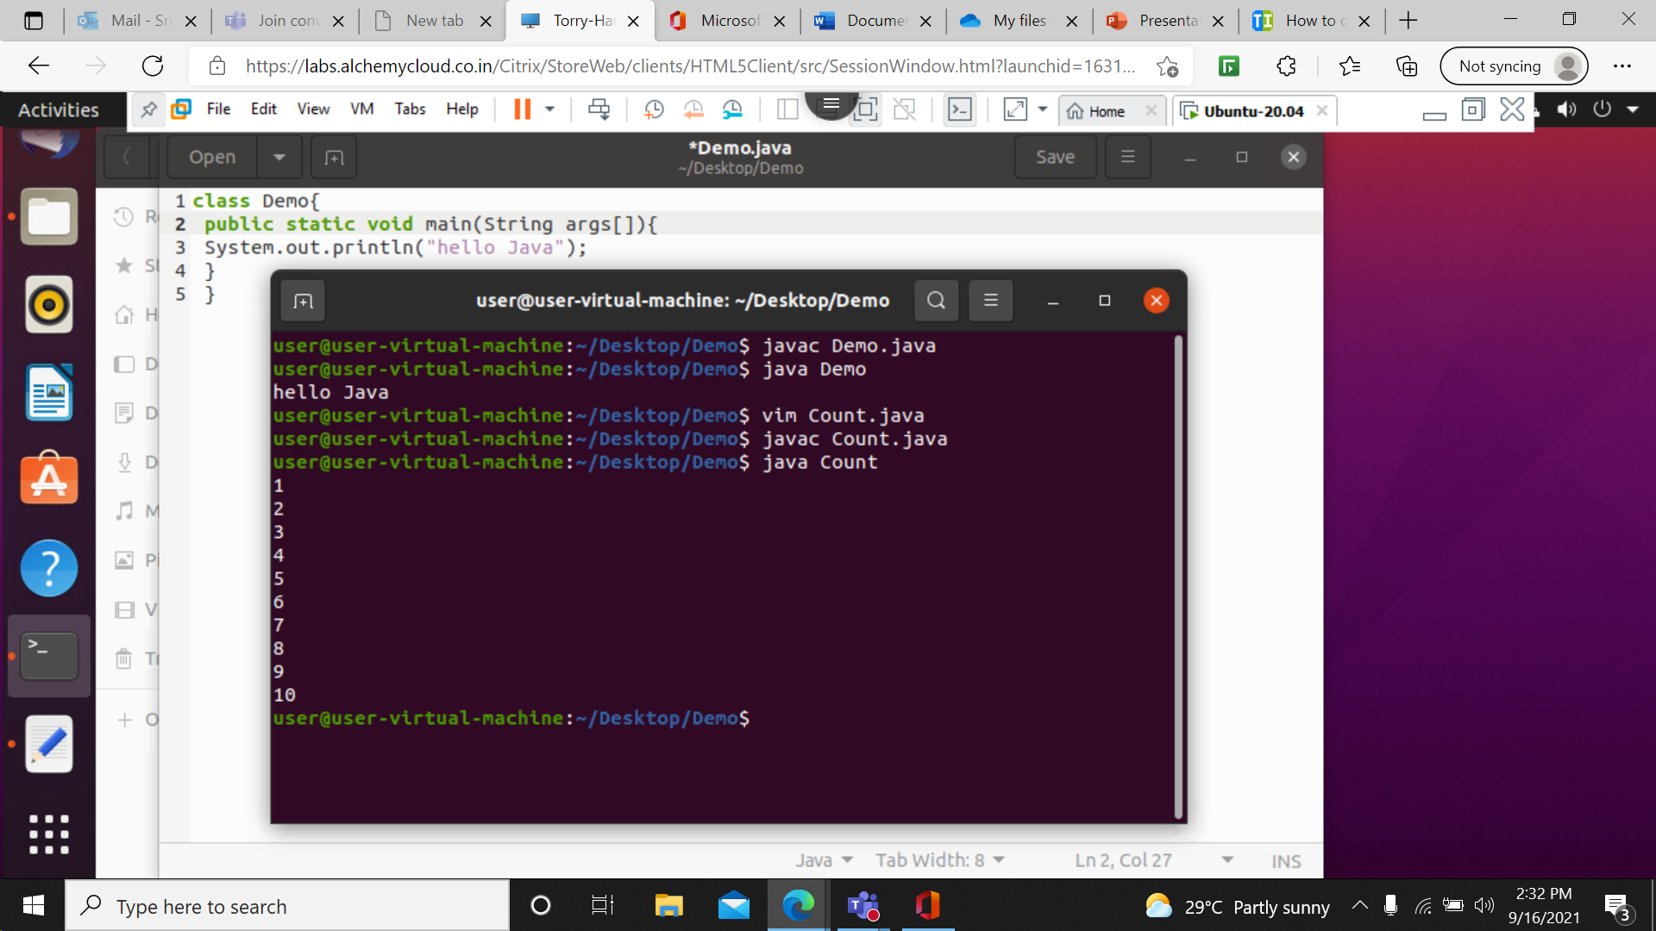

Slide 7
Thankyou

